Slide 1
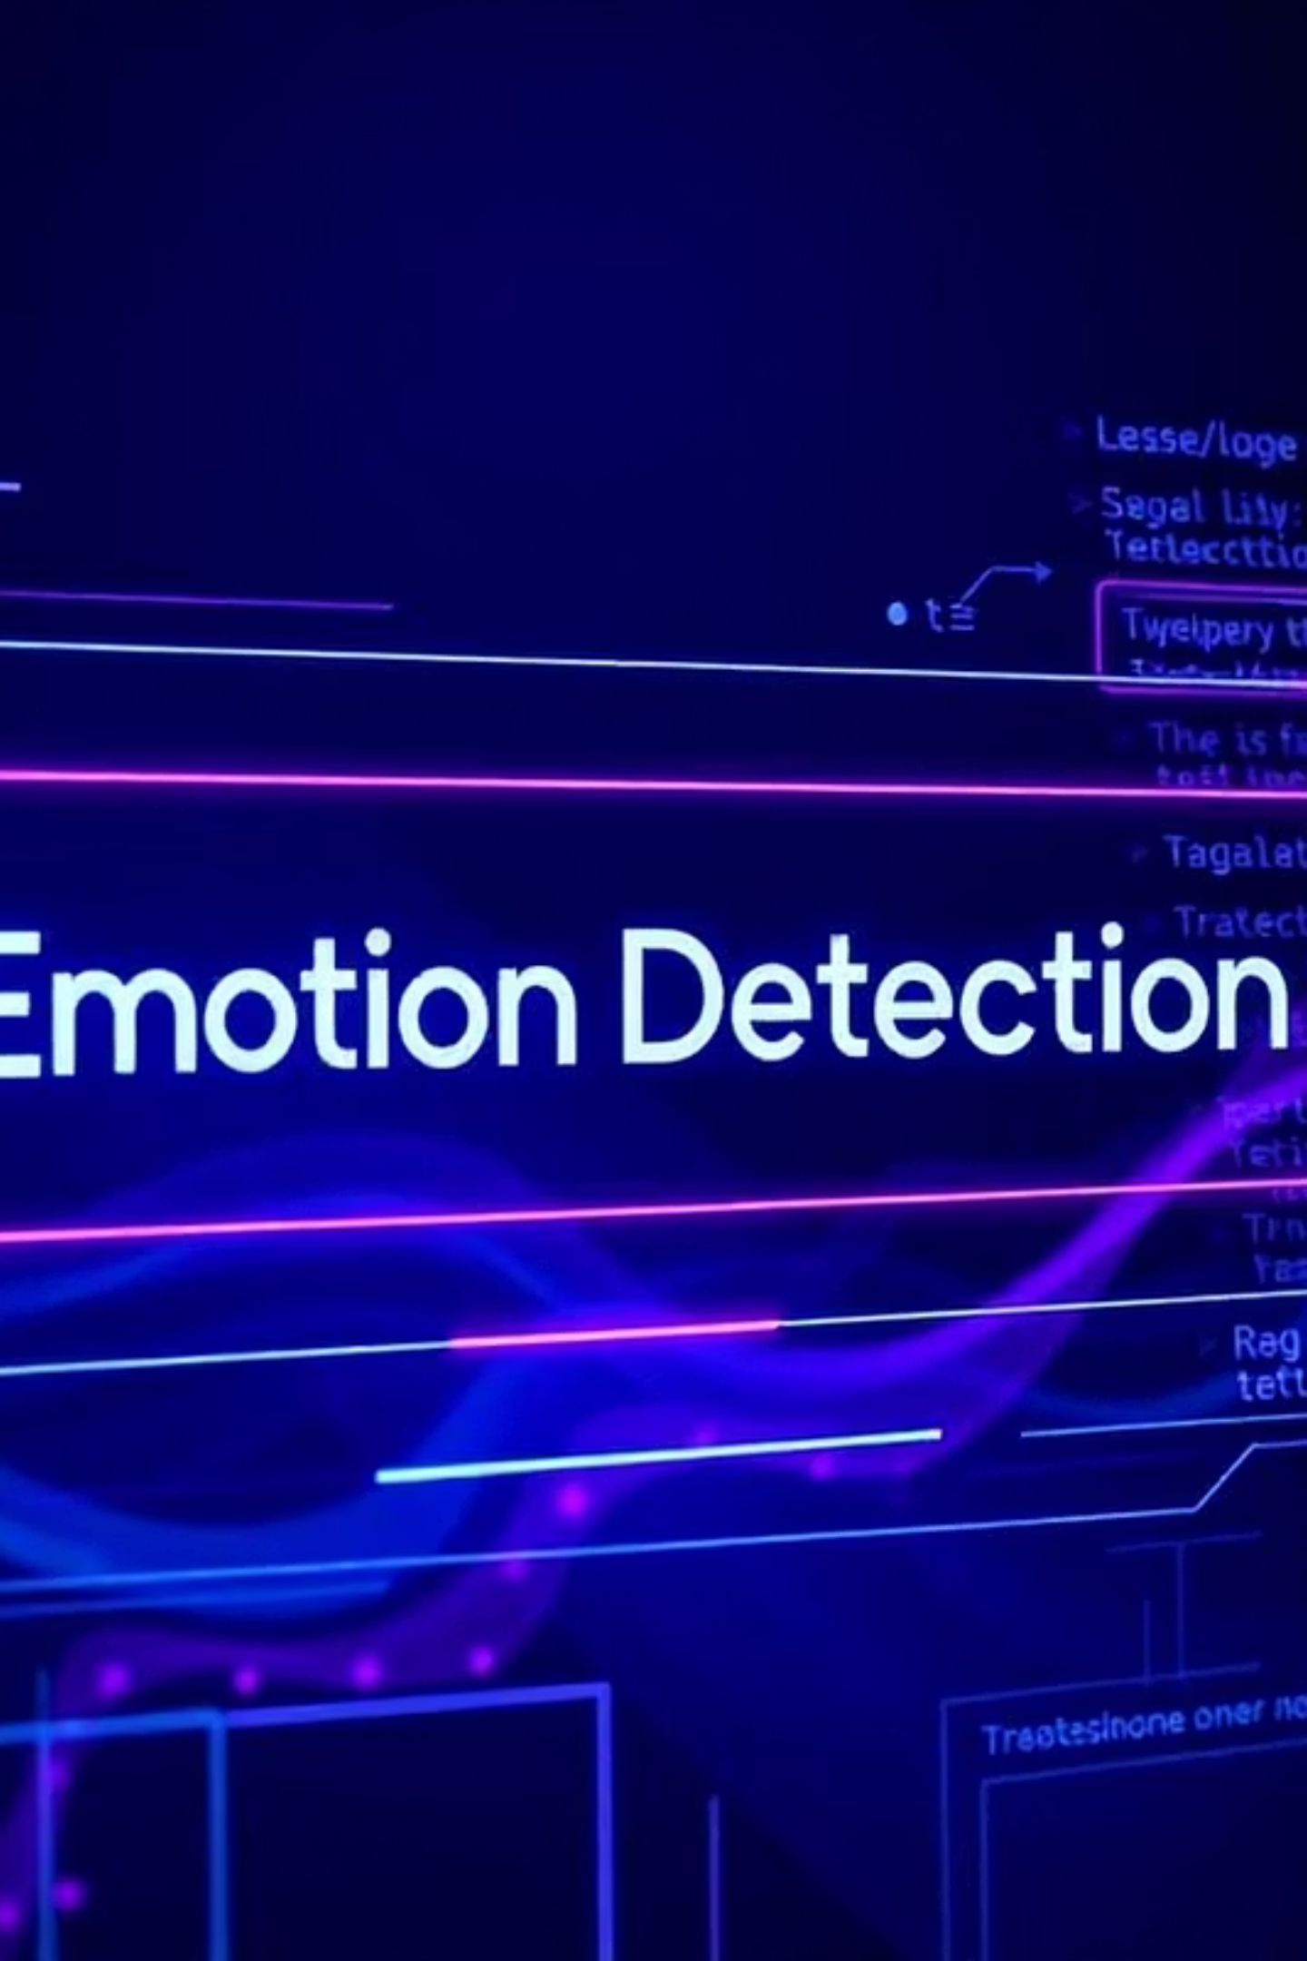
Real-Time Text Emotion Detection Web App using Machine Learning
Presented by: Dev Verma | MRIIRS | 14/07/2025

Slide 2

Introduction to Emotion Detection
Emotion detection from text involves identifying and categorizing the emotional tone embedded within written content. This goes beyond simple sentiment analysis (positive/negative) to discern specific human emotions.
It's crucial for understanding user feedback, analyzing social media trends, and enhancing customer service interactions. Automated detection offers speed and consistency, vital in today's data-rich environment.

Slide 3
Project Objective & Problem Statement
Project Objective
Problem Statement
To develop a real-time web application that accurately predicts and displays emotions from user-entered text using machine learning techniques.
Manually discerning emotions from vast amounts of text data is time-consuming and subjective. There is a clear need for an automated, intelligent, and efficient solution to provide faster, unbiased analysis.

Slide 4




Proposed Solution: NLP Web Application
Web-Based Application
Machine Learning Powered
Accessible via any web browser for immediate analysis.
Leveraging algorithms for intelligent classification.
Natural Language Processing
Six Core Emotions
Analyzing human language for emotional cues.
Joy
Sadness
Anger
Love
Fear
Surprise

Slide 5

Data & Preprocessing
Labeled Emotion Dataset
The core of our model relies on a pre-labeled dataset where each text entry is paired with its corresponding emotion (e.g., "I'm so happy today!" → Joy).
Preprocessing Steps:
Text cleaning (removing special characters, numbers)
Tokenization (breaking text into words)
Lowercasing
Stop word removal (e.g., "the," "is")
Lemmatization (reducing words to their base form)

Slide 6






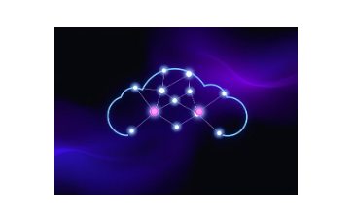
Technology Stack
Python: Core language for backend logic and ML.
Scikit-learn: Machine learning library for model building.
Flask: Lightweight web framework for the backend API.
HTML/CSS/JavaScript: Frontend for interactive user interface.
Joblib: For efficiently saving and loading the trained ML model.
GitHub + Render: Version control and seamless cloud deployment for accessibility.

Slide 7
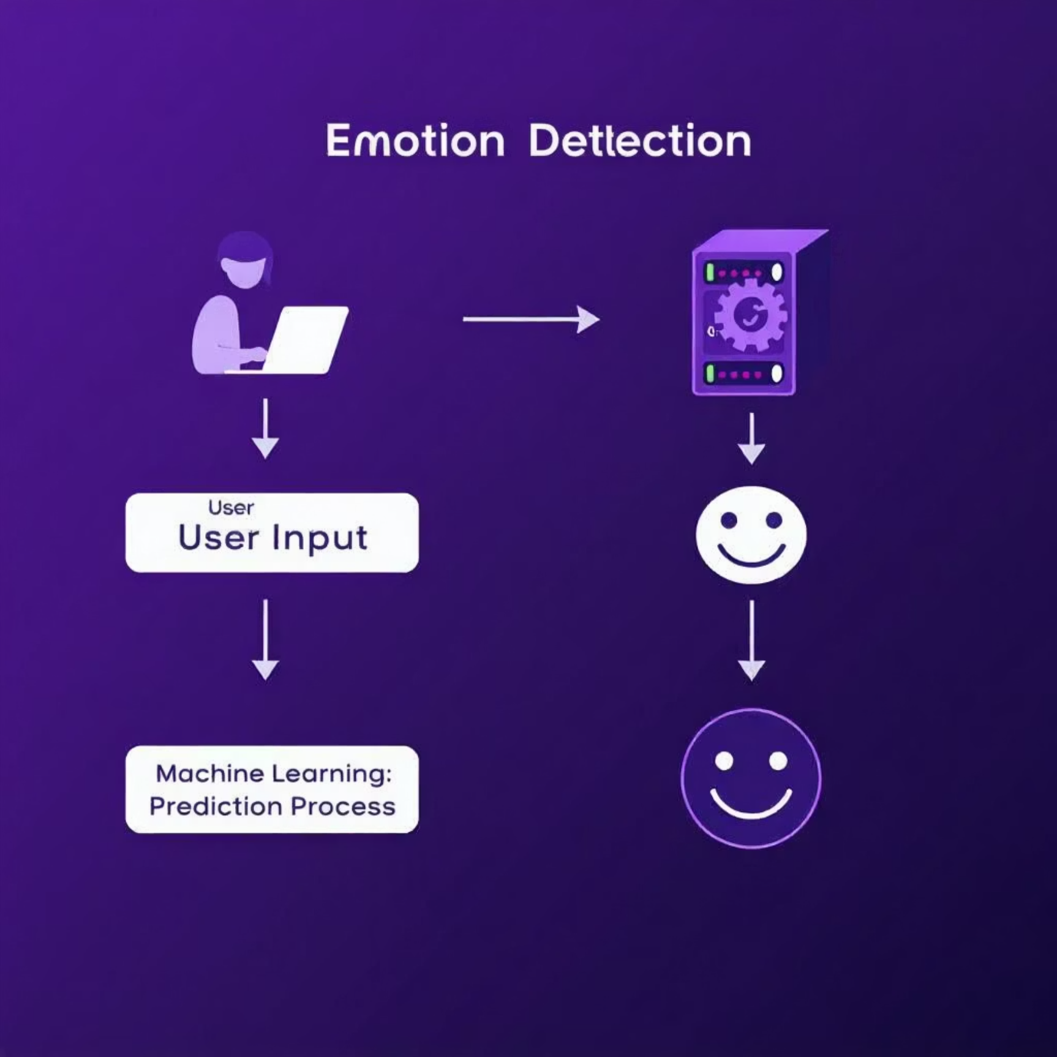
Modeling Approach & Architecture
Modeling Approach:
Architecture Diagram:
TF-IDF Vectorization
1
Transforms text into numerical feature vectors, representing word importance in documents.
Logistic Regression
2
A robust and efficient classifier for multi-class emotion prediction.
Trained Dataset
3
Model is trained on a comprehensive labeled emotion dataset for high accuracy.
User Input → Flask Backend → ML Model → Prediction Output

Slide 8
Conclusion & Future Scope
92%
<1s
24/7
Accuracy Achieved
Real-Time Analysis
Automated Insights
The model demonstrates high accuracy in detecting specified emotions.
Instantaneous emotion prediction for rapid insights.
A powerful tool for continuous sentiment and emotion analysis.
Future Enhancements: Expand emotion categories, integrate voice input, suggest emojis based on emotion, explore advanced deep learning models for improved performance, and enhance multilingual support.
Thank You!
GitHub Repository : https://github.com/devvv04/real-time-text-emotion-detector

